Slide 1
Final Project: Boids
CSCI x810 Computer Graphics Final Project
Jorrin Thacker

Slide 2
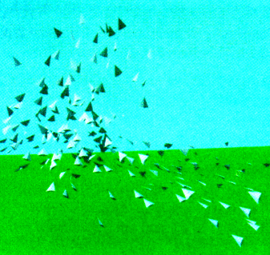
What is a Boid?
Boid – A simulated bird like “bird-oid”
Elaboration of a particle system simulation
Each Boid is simulated independently
Creates a “computer model of coordinated animal motion such as bird flocks and fish schools” – Reynolds

Slide 3
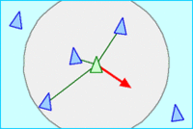
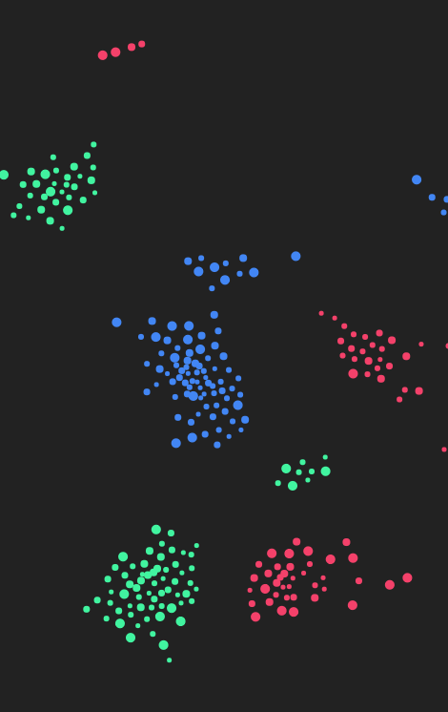
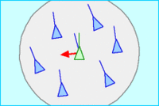
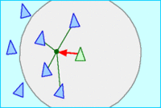
What makes a Boid work
Separation
3 Main rules
Separation – steer to avoid flock mates
Alignment – steer to avg. direction of flock mates
Cohesion – steer to center of flock mates
Additional Rules
Collision Avoidance – steer to avoid obstacles
Bias – gravitate towards their type
Leadership – follow the Boid in front of it
Alignment
Cohesion

Slide 4
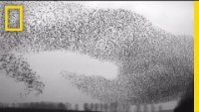

Slide 5
Milestone 1 (Complete)
Project Setup
Custom Shaders
Simple Boid Logic (Movement, Rotation)
Wall Boundaries

Slide 6
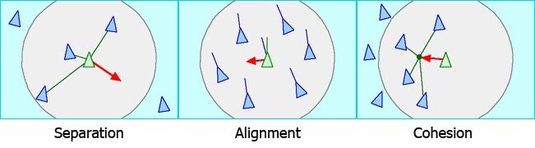
Milestone 2 (Complete)
Implement Boid Rules (Separation, Alignment, Cohesion)
Add collision detection for boids (Walls, Objects)
Create Boid Playground with many objects to navigate (cubes, Spheres, Torus, etc.)

Slide 7
Milestone 3 (Complete)
Add controls to change aspects of Boids
Add additional Rules (Leadership, Swarms/Racism, etc.)
Use a better Model for the boids

Slide 8
Project Demo

Slide 9
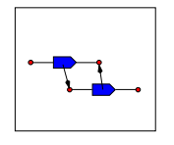
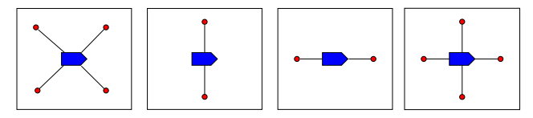
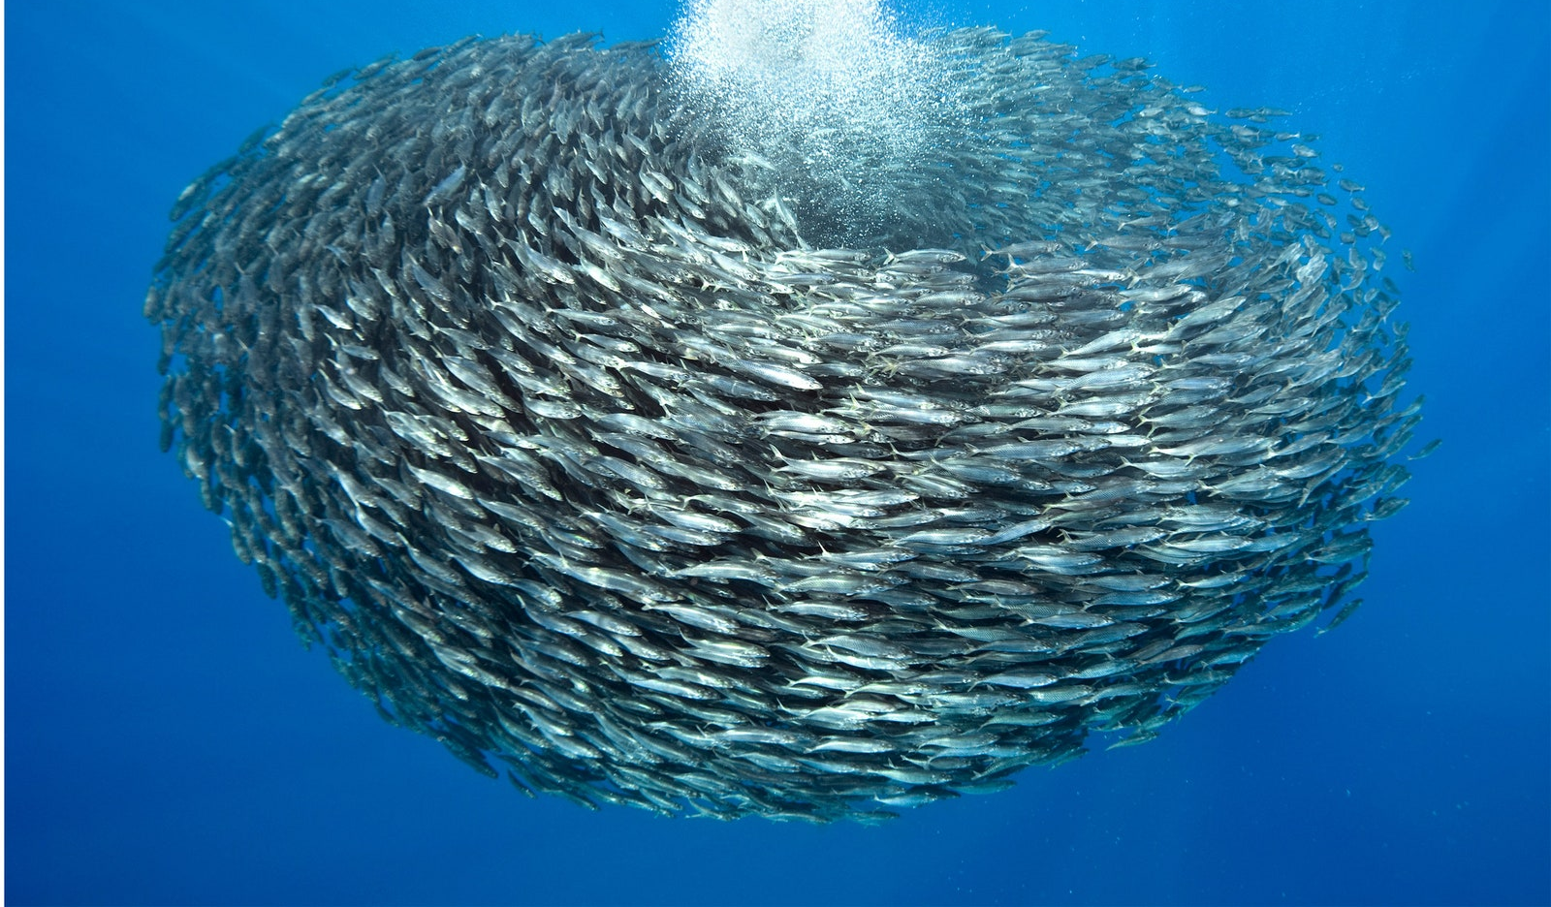
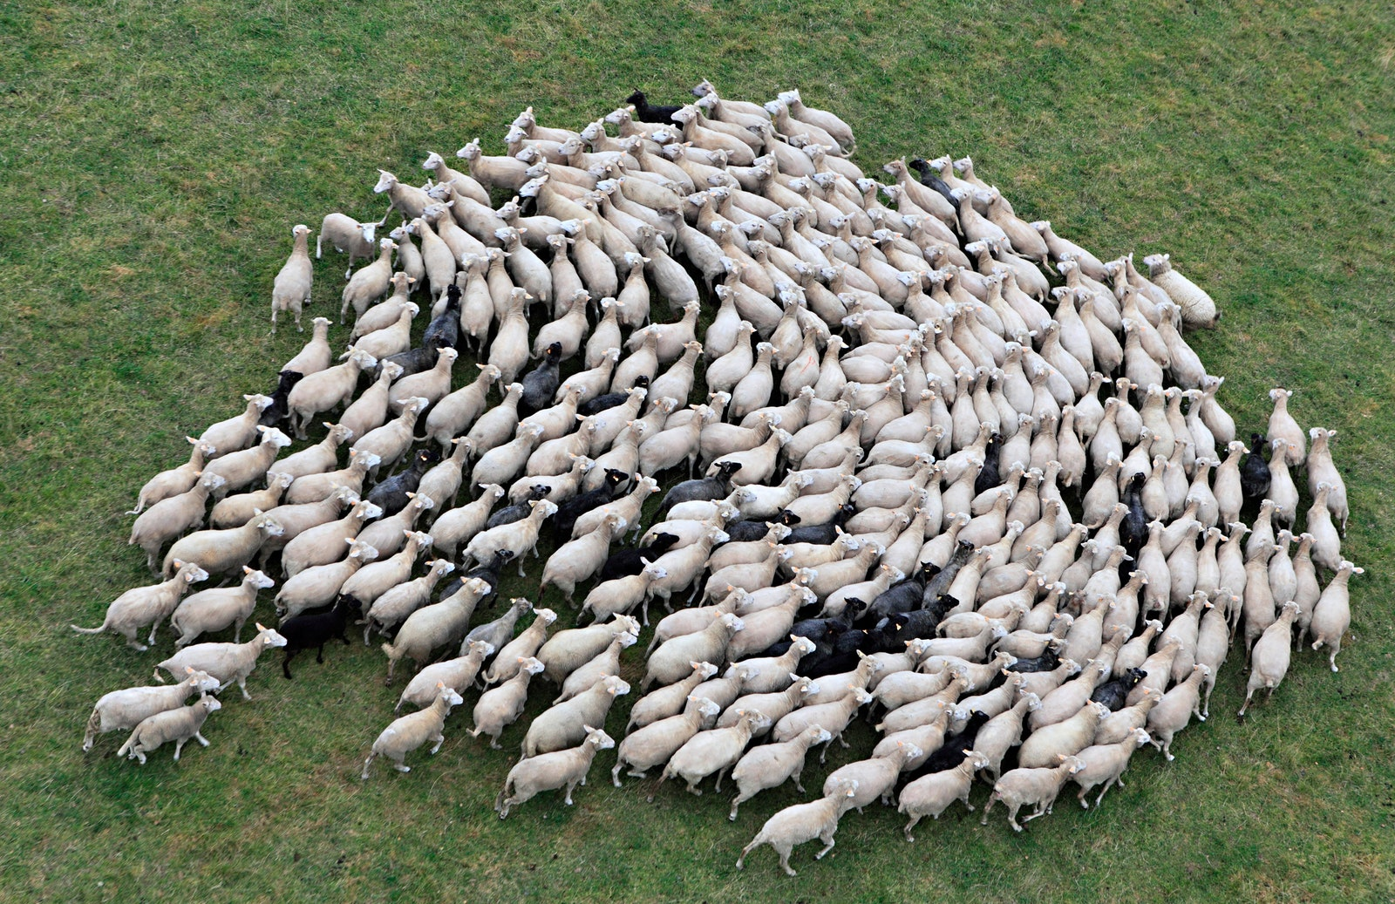
Future Work
– Add compute shader (for telling which boids are near each other)
– Implement a more animalistic flock formation (V-formation, torus, diamond, etc.)
– Add other formation options for the type of flock the boids will follow (fish, ants, locusts, etc.)

Slide 10
Sources
Starling Flock Video - https://www.youtube.com/watch?v=V4f_1_r80RY
Wikipedia page - https://en.wikipedia.org/wiki/Boids
Original paper by Craig Reynolds: https://www.red3d.com/cwr/papers/1987/boids.html
Youtuber that introduced me to boids: https://www.youtube.com/watch?v=bqtqltqcQhw
Animalistic flocks: https://www.wired.com/2013/03/powers-of-swarms/
Formation techniques: https://cobweb.cs.uga.edu/~maria/papers/icra-2000.pdf
Implementation Design: https://jumpoffboids.netlify.app/

